Slide 1
Thorium LFTR Molten Salt Reactors
The Good Reactor
CA Energy Commission
Workshop on Nuclear Issues
Walter Horsting, Principal
Business Development International
June 19, 2013

Slide 2
Transformational Energy
Fire
Steam
Electricity
Nuclear
Thorium LFTR –
what Fusion would like to be

Slide 3
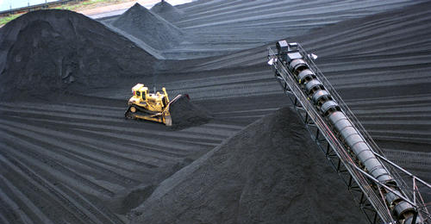
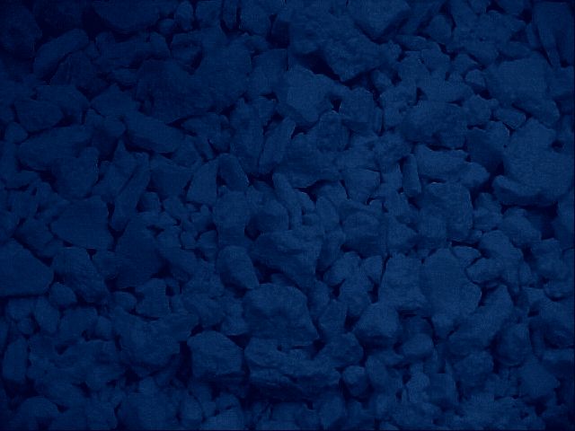
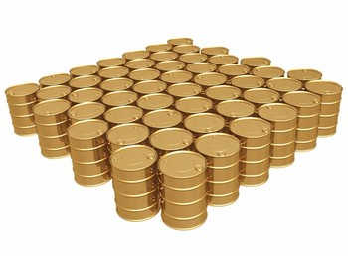
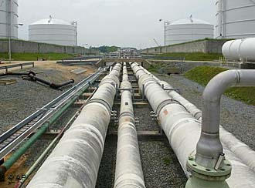
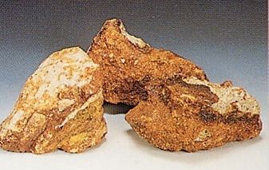
World Energy Consumption
The Future:
Energy from Thorium
5.3 billion tons of coal (128 quads)
31.1 billion barrels of oil (180 quads)
2.92 trillion m³ of natural gas (105 quads)
6600 tons of thorium (500 quads)
Energy Density of Fission Fuel is more than 1 Million times greater than any fossil fuel !!!
65,000 tons of uranium ore (24 quads)
Notes:
Fissile fuels are a Million+ times as energy dense as any fossil fuel. Accessible thorium reserves could supply the world energy for thousands of years. (probably millions to billions)
Thorium is so energy dense, a mere 6600 tons of thorium could provide the energy equivalent of the combined 5.3 billion tons of coal, 31.1 billion barrels of oil, 2.92 trillion cubic meters of natural gas, and 65,000 tons of uranium that the world consumes annually. What is more, estimated globally accessible thorium reserves could supply the world's energy needs for thousands of years.
This would enable us to replace global energy with energy generated from thorium for a modest amount of natural material. Compared to current uranium consumption alone, only about one tenth as much thorium would need to be mined to generate all global energy demand.

Slide 4
Thorium LFTR Top Ten Attributes #1 - Abundance
The worldwide abundance of the element thorium promises widespread energy independence through Liquid Fluoride Thorium Reactor (LFTR) technology. With LFTR, a handful of thorium can supply an individual’s lifetime energy needs; a grain silo full could power North America for a year; and known thorium reserves could power advanced society for many thousands of years.

Slide 5


Thorium fuel is plentiful and inexpensive.
500 tons, entire US, 1 year
Millions of tons worldwide
Energy security for all
$300,000 per ton
1 ton, 1 city, 1 GW-year
← dense, silvery, ½ m, 1 ton thorium sphere
http://minerals.usgs.gov/minerals/pubs/commodity/thorium/690798.pdf
Notes:
And the world supply high concentration is 3 million tons (IAEA)
US has 3200 tons in storage.
Over 1 million in Lemhi Pass … 440,000 tone in US says USGS
NH granite 56 PPM

Slide 6
LFTR electricity can cost 3 cents/kWh.
Electricity cost, cents/kWh
 | LFTR | Coal | Gas | Wind | Solar | Biomas
Capital cost recovery | 2.0 | 2.8 | 1.0 | 17.4 | 10.0 | 4.0
Fuel | 0.004 | 1.8 | 2.8 | 0 | 0 | 4.7
Operations | 1.0 | 1.0 | 1.0 | 1.0 | 1.0 | 1.0
Total | 3.0 | 5.6 | 4.8 | 18.4 | 11.0 | 9.7

Slide 7
Thorium LFTR Top Ten Attributes #2 Proven Technology
LFTR is based on demonstrated technology with sound operational fundamentals proven by 20,000 hours of reactor operation at Oak Ridge National Laboratory in the late 1960′s.
Despite recognized, compelling advantages, LFTR development stalled when political and financial capital were concentrated instead on fast-spectrum plutonium breeding reactors; and its inability to produce bomb making material.

Slide 8
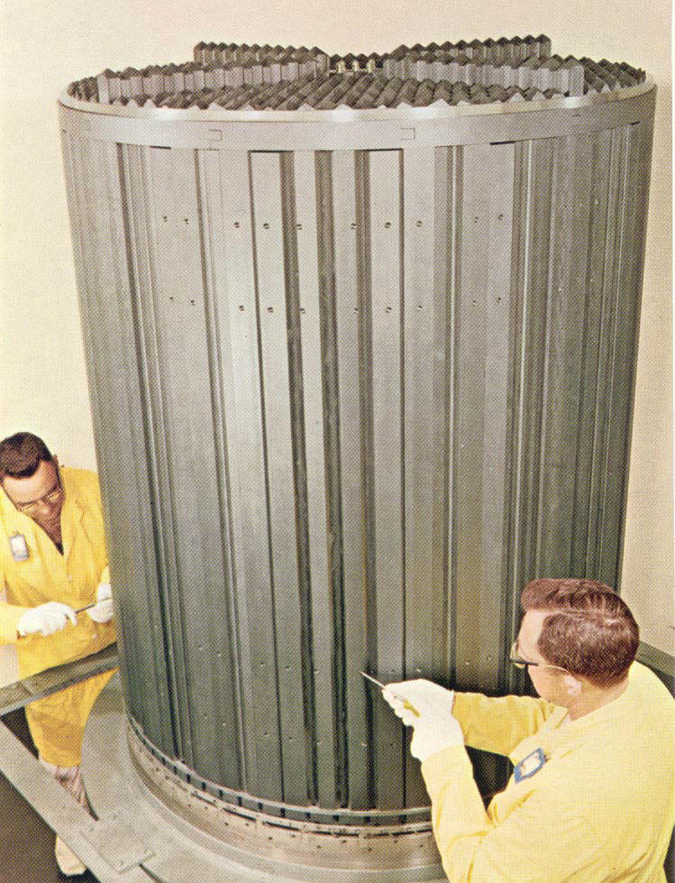
The Molten Salt Reactor Experiment ran from1965 to 1969.
Salt flowed through channels in this graphite core.
Notes:
Weinberg had foreseen today's energy and atmospheric CO₂ crises. He directed Oak Ridge to design and test another successful molten salt reactor experiment. It was tested with uranium-233 made from thorium. He wrote “humankind’s whole future depended on” it. Though successful, LFTR was sidelined for uranium/plutonium solid fuel technologies, which were also useful for weapons.

Slide 9
Thorium LFTR Top Ten Attributes #3 Low Pressure Safety
LFTR operates at low pressure, is chemically and operationally stable, and passively shuts down without human intervention with a gravity fed drain tanks. Low pressures eliminate the need for massive and costly pressure containment vessels, 80-160 atmosphere plumbing and alleviate safety concerns about high-pressure releases to the atmosphere.
LFTR offers significant gains in safety, cost and efficiency with greatly reduced environmental impact relative to existing light-water reactors (LWRs).

Slide 10
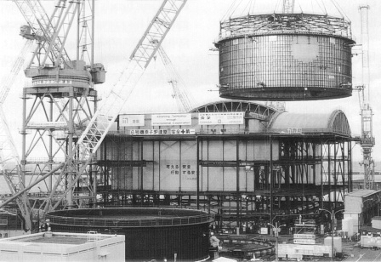
LFTR needs no costly 160-atmosphere pressure vessel and containment dome.
Notes:
100 ton crawler cranes used for onsite PWR construction add expense.

Slide 11
Thorium LFTR Top Ten Attributes #4 Efficient
LFTR is more efficient, using 99% of the thorium-derived fuel, versus the 1% of fuel burned in LWRs.
LFTRs burn scarce fissile reserves as a one-time consumable; LFTR consumes fertile thorium, using fissile reserves only to start the thorium fuel-cycle.

Slide 12
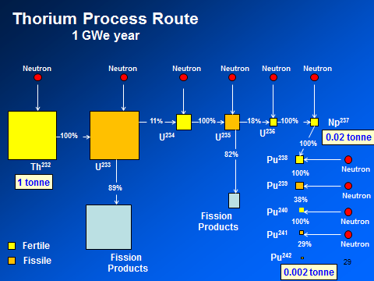

Slide 13
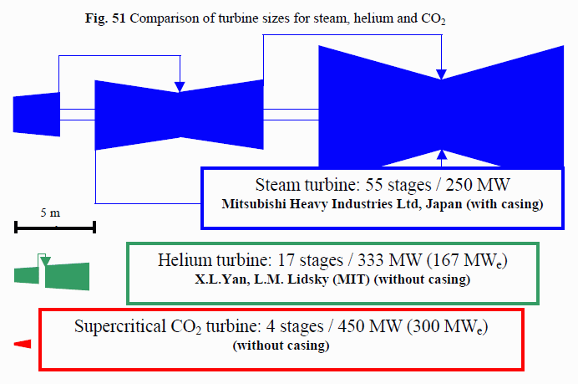
Helium Turbines & supercritical CO2 turbines
Savings in size and efficiencies
http://web.mit.edu/jessiek/MacData/afs.course.lockers/22/22.33/www/dostal.pdf
Notes:
45% Sandia

Slide 14
Thorium LFTR Top Ten Attributes #5 Burn Nuclear Waste
LFTR can use a range of nuclear starter fuels and can consume plutonium and other actinides from legacy spent nuclear fuel stockpiles. Molten salt reactors were started on all three fuel options and once operational, LFTR can continue operation with just thorium.

Slide 15
Thorium LFTR Top Ten Attributes #6 Carbon Free Energy
LFTR produces safe, sustainable, carbon-free electricity and a range of radioisotopes useful for medical imaging, cancer therapy, industrial applications and space exploration.
LFTR waste heat can be used to desalinate sea water and high primary heat can drive ammonia production for agriculture, fuels or synthesis of liquid hydrocarbon fuels & garbage to fuels.

Slide 16
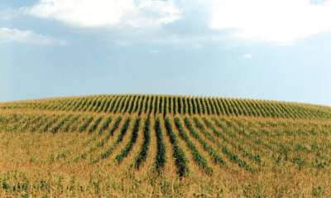
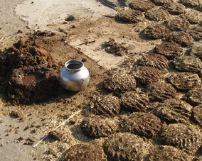
Hydrocarbon fuels can be synthesized from H₂ and almost any carbon source.
Farming produces 3 tons of dry biomass per acre-yr. -- half is carbon.
Don’t burn it! Hydrogenate it.
1.7 T biomass → 1 T fuel.
US farm land: 1 G acres US annual fuel use: 1 GT
World cattle dung of 2.5 GT could make 1.5 GT fuel.
http://ecen.com/eee57/eee57e/carbon_content_in_biomass_fuel.htm
Notes:
NOT energy from biomass
http://en.wikipedia.org/wiki/Energy_policy_of_the_United_States#Petroleum 20.8 M bbls/day, or 7592 M bbls/yr
7.3 b
http://ecen.com/eee57/eee57e/carbon_content_in_biomass_fuel.htm
bl/tonne , ergo 1 GT
Need water, carbon, energy
Forestry the same.
16

Slide 17
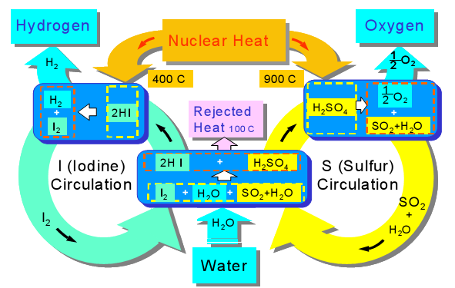
Produce hydrogen with LFTR.
Dissociate water with sulfur-iodine or copper-chlorine cycle.
Notes:
http://wwwtest.iri.tudelft.nl/~klooster/reports/hydro_slides_2003.pdf
45% efficient 650 C

Slide 18
Thorium LFTR Top Ten Attributes #7 Magnitudes less Waste
Most LFTR byproducts stabilize within a decade and have commercial value; the minor remainder has a half-life of less than 30 years, stabilizing within hundreds rather than tens of thousands of years.
LFTR waste is primarily fission products and does not include unspent fuel, fuel cladding, or long-lived transuranics typical of legacy spent nuclear fuel. No Need for Yucca Mountain!

Slide 19

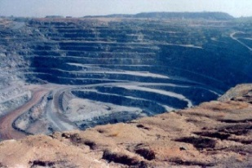
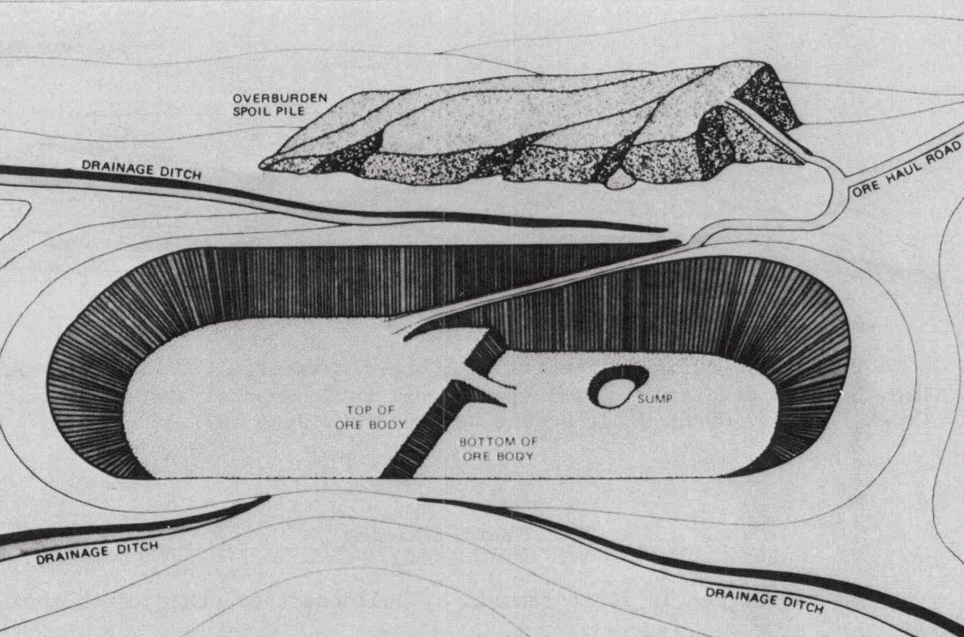
LWR vs. LFTR Fuel flow (1 GWe plant)
250 t uranium containing 1.75 t U-235
35 t of enriched uranium (1.15 t U-235)
U-235 is burned; some Pu-239 is formed and burned.
35 t of spent fuel containing:
33.4 t U-238 0.3 t U-235 1.0 t fission products 0.3 t Pu
215 t of depleted U-238 (0.6 t U-235)
800,000 t ore
1 t fission products
In 10 yrs, 83% FP stable.
17% FP stored ~300 years.
1 t thorium
Fluoride reactor converts Th-232 to U-233 and burns it.
200 t ore
.0001 t Pu
Notes:
Compare to standard reactor. “almost” no U, Pu. Need to keep U-233 out of waste stream. Depends on the effectiveness of the chemical separation of the waste stream.
19

Slide 20
Thorium LFTR Top Ten Attributes #8 Modular & Build at Need
LFTRs can be mass-produced in a factory and delivered and reclaimed from utility sites as modular units. Modular LFTR production offers reduced capital costs and shorter build times. Modular installation near the point of need also eliminates long transmission lines. Higher temperatures and turbine efficiencies enable air-cooling away from water bodies.

Slide 21
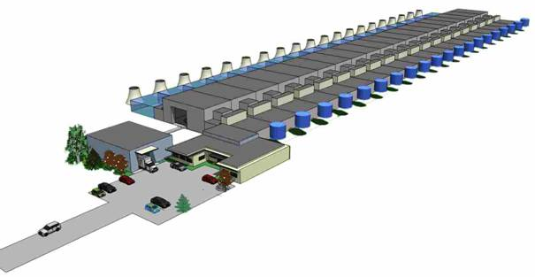
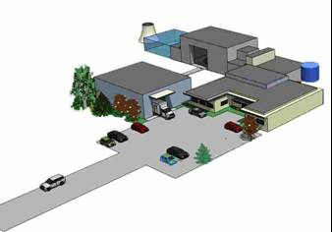
SCALABLE, MODULAR DESIGN SERVES ALL APPLICATIONS
SINGLE 50 MW MODULE OR TWENTY 50 MW MODULES
50 MW Plant
1 GW Plant
Construction time for single 50 MW module: 12 – 18 months (estimate)
Carrying cost for large plant consisting of 22 factory assembled modules: 2-3 years (vs. 7 years for an AP1000)
21

Slide 22
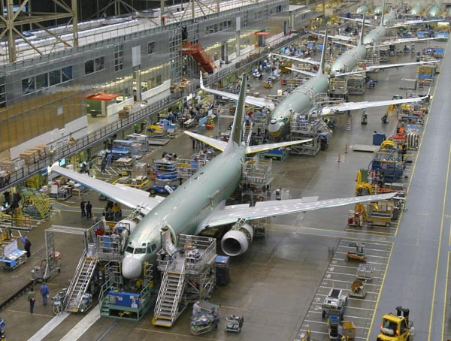
Boeing factories can produce a $200 million aircraft every day.
Notes:
Factory production cuts costs. Boeing Aircraft produces similar cost units with similar concerns about quality, materials, and safety.
477 in 2011, up to $330 million each.
Produce LFTRs in such factories.

Slide 23












THORIUM REACTOR FINANCIAL PROFILE
Before Tax ROI
35.2%
All in cost to build, O&M, Fuel
$1,800/KW
Residual fuel value
>$1B after 30 yrs
Global revenues
$60B in 10 yrs
Regional energy subsidy savings
$8-12 B per year
Regional profit
$22.2 M/yr/100MW
23

Slide 24
Thorium LFTR Top Ten Attributes #9 Can’t Make Bombs
LFTR and thorium are proliferation resistant. Thorium and its derivative fuel, uranium-233, are impractical and undesirable for weaponing efforts relative to well-known uranium enrichment and plutonium breeding pathways.
After 60 years of thorium research, none of the world’s tens-of-thousands of warheads are based on the thorium fuel-cycle.

Slide 25
Thorium LFTR Top Ten Attributes #10 Cannot Fail or Meltdown
Liquid salt fuels cannot fail or meltdown. The liquid salt fuels have a thousand-degree liquid range, eliminating the possibility of fuel failure scenarios from overheating or meltdown like at Fukushima.
Liquid fuel is a key difference from LWRs with LFTR’s liquid salts serving as both a fuel carrier and coolant. The salts are not reactive with water or the atmosphere. Fuel can be added to the salts and byproducts removed while the reactor remains online.

Slide 26
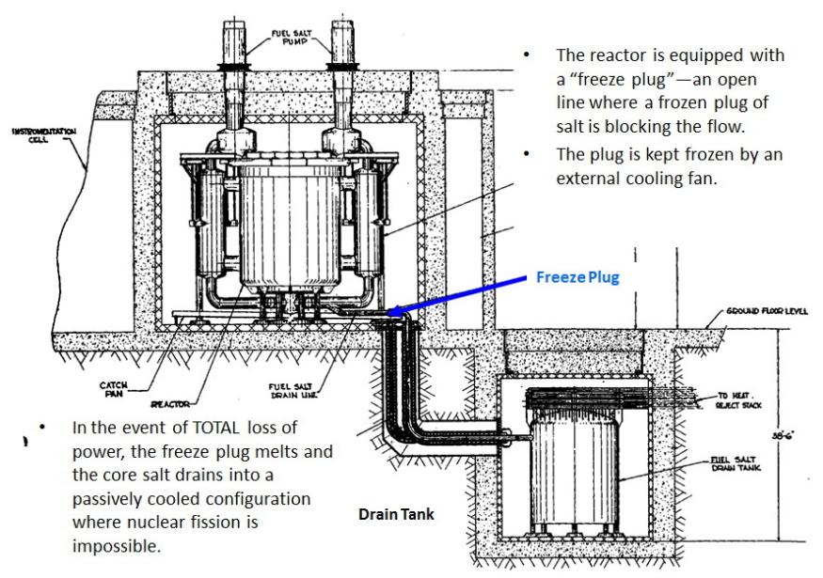
Walk-away safe LFTR reduces defense-in-depth systems costs.
Stable reactivity.
Can’t melt down.
No propulsive pressure.
Melting freeze plug dumps salt to tank.
Salt from rupture or leak will solidify.
Freeze plug
Notes:
Thermal.

Slide 27
CA Transformational Projects
CA led the world building Transcontinental Rail & locomotives…. now attempting High Speed Rail
Electrification of Sacramento, Rancho Seco, San Onofre & Diablo Canyon….now two mothballed
Early photovoltaic adaption…then lost to China a world market
CA Water Project helps feed the world….now plan to spend $14 B without producing any water
Airplane industry to rocket age…now regulatory, tax and power costs driving Business out of state
What will, help the state through its metamorphosis to a abundant, clean, safe energy?

Slide 28
Opportunity for California
Redirecting $14B Delta Water Tunnel Spending into 8-10 GW for Desalination for Southern CA. Big Dig and Bay Bridge projects went over budget 2-3X or 16-30 GW buying power
Desalination of Water for Southern CA
Sea Water to Fuel ( US Naval Research Inst.)
Energy for Industrial Processes
Garbage to Fuel
Burn Nuclear Waste from CA 3 reactor sites
Distributed power production where it is needed
Don’t let China use US technology to own power production for the next 50 years

Slide 29
Thorium LFTR The Good Reactor A Green Solution for CA
Nuclear fission and nuclear fusion electrical generation plants are indeed as “Renewable” as wind, solar, hydro, biomass, and geothermal energy technologies are and that nuclear fusion and nuclear fission should be defined as “Renewable” and as “Clean Energy”.
Clean Energy Standards should be based upon the amount of direct and indirect pollution (as well as GHGEs (Green House Gas Emissions)) produced per energy output would serve Californians better than current Renewable Standards.

Slide 30
Additional Information
www.energyfromthoriums.com Not for profit policy advocacy
http://www.youtube.com/watch?v=uK367T7h6ZY 5 min video
http://www.youtube.com/watch?v=AZR0UKxNPh8 In depth video
http://www.thoriumpowercanada.com/news/ Production ready design
http://www.thoriumenergycheaperthancoal.com/
http://newenergyandfuel.com/http:/newenergyandfuel/com/2012/06/29/two-a-half-nations-start-thorium-nuclear-power-research/ China & DOE research
http://jrse.aip.org/resource/1/jrsebh/v4/i3/p033111_s1?isAuthorized=no Navy Research Institute Sea Water to Jet Fuel
http://transatomicpower.com/company.php Waste-Annihilating Molten Salt Reactor - WAMSR
http://iaea.org/NuclearPower/Desalination/ IAEA Desalination

